Slide 1
AI in healthcare
CEP 146 – Group Presentation 2

Slide 2
Table of contents_
01
02
03
04
Introduction to AI Healthcare
AI in Drug Discovery + Healthcare Operation
Key Ethical Issues
Conclusion

Slide 3
01
Introduction to AI Healthcare

Slide 4
Introduction to AI Healthcare
1. The Growing Role of AI in Modern Healthcare
2. Real-World AI Tools Transforming Medical Diagnosis
AI in healthcare uses machine learning to analyze medical data such as scans, lab results, and electronic records. Instead of replacing doctors, it acts as a helpful “second reader” that can process large amounts of information, detect subtle patterns, and support decisions in diagnosis and treatment. This is important because healthcare systems are facing staff shortages, aging populations, and increasing amounts of digital data.
AI is already being used in diagnostic imaging by companies like Google and Siemens to read X-rays, CT scans, and MRIs more efficiently. Tools such as Google’s Med-Gemini can flag suspicious findings, while Siemens provides multiple AI-assisted imaging technologies. Beyond imaging, FDA-approved systems like IDx-DR can detect diabetic retinopathy from retinal photos, bringing specialist-level screening into everyday clinics.

Slide 5
02
AI in Drug Discovery + Healthcare Operation

Slide 6
AI in Drug Discovery + Healthcare Operation
AI-Designed Drugs: A New Era in Medicine
Speeding Up Drug Discovery with AI
AI Solutions Improving Hospital Operations
AI is transforming healthcare and drug discovery. One major breakthrough is AI-designed drugs, where algorithms identify disease targets and create new molecules. The first fully AI-designed drug, INS018_055, has already entered human trials. This matters because AI can discover treatments faster, cheaper, and sometimes find designs humans might miss.
AI also accelerates drug development by scanning huge datasets, generating millions of digital molecules, predicting their safety, and selecting the best ones cutting timelines from years down to months. Tools like Alpha Fold push this even further by accurately predicting protein structures, removing a key scientific barrier in drug design.
In hospitals, AI improves daily operations. It predicts patient wait times, helps manage beds, equipment, and staff, identifies delays, and automates scheduling, paperwork, and alerts. This reduces overcrowding, saves resources, and gives healthcare workers more time to focus on patient care.

Slide 7
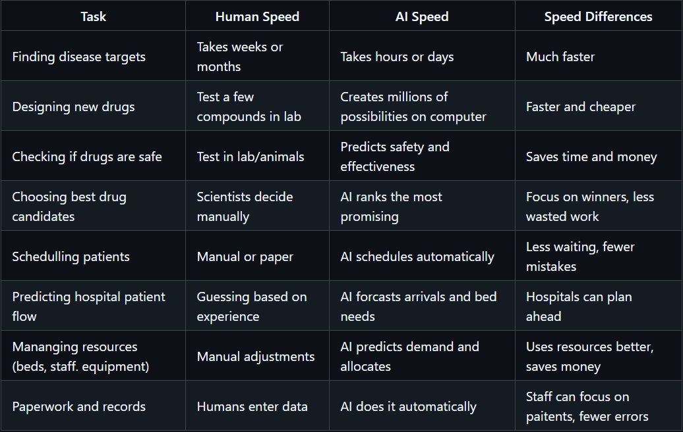
Comparison Table between Human beings vs AI Speed

Slide 8
03
AI in Drug Discovery + Healthcare Operation

Slide 9
Key Ethical Issues
Fairness, Transparency & Patient Rights
AI can worsen health inequities if trained on biased data, and many models are “black boxes,” making their decisions hard to explain. This affects trust and informed consent.
Privacy, Data Protection & Accountability
AI relies on massive amounts of sensitive health data, raising concerns about privacy and misuse. And when AI makes a mistake, responsibility is unclear for doctors, hospitals, or developers?
AI-Enhanced Care & Clinical Support
AI will be built into everyday tools like EHRs, imaging systems, and telehealth. It will predict diseases earlier, personalize treatments, and support clinicians and patients through AI “copilots.”
Regulation, Governance & Workforce Changes
Stricter rules will guide how clinical AI is tested and monitored. Medical education is adding AI literacy, and new roles for example, like clinical AI leads and data stewards—are emerging to ensure safe use.

Slide 10
Conclusion_
AI has the potential to transform healthcare by improving diagnosis, personalizing treatment, and streamlining hospital operations. However, ethical issues like bias, privacy, and accountability must be carefully managed. Strong regulation, proper training, and new clinical roles will be essential to ensure AI is used safely and fairly. With these safeguards, AI can enhance care while protecting patients and clinicians alike.

